Slide 1
Unit 6: Pipelining
Multiprogramming, Multiprocessing, Single instruction single data stream (SISD); Single instruction multiple data stream (SIMD); Multiple instruction single data stream (MISD); Multiple instruction multiple data stream (MIMD), Multiprocessors: Shared memory and distributed memory, Parallel processing: Pipeline processing, Vector processing, Array processors. Pipelining: Arithmetic Pipeline, Instruction Pipeline: Example: Four-Segment Instruction Pipeline. Pipelining Conflicts: Resource conflicts, Data dependency and Branch difficulties, Pipeline Conflicts Handling techniques: Throughput and Speed; RISC pipeline;

Slide 2
Materials
“Computer System Architecture”, 3rd edition, M. Morris Mano, Pearson Publications.
“Shared versus distributed memory Multiprocessors”, Harry F. Jordan
“Computer organization and Design, the hardware software interface”, 5th edition, David A. Patterson and John L. Hennessy
“Computer organization and Embedded Systems”, 6th edition, Carl Hamacher, Zvonko Vranesic, Safwat Zaky, Naraig Manjikian

Slide 3
Multiprogramming
Multiple programs run parallelly
Sharing of a computer by different independent jobs
Processors do not stay idle; used for increasing efficiency
Eg: when a program is waiting for some I/O operation, the CPU can work on another program.
Mainly two types of multiprogramming operating systems:
Multitasking Operating System
OS allows more than one program to execute simultaneously
Programs are moved in and out of memory

Slide 4
Multi-user operating system
Allows multiple users to share the processing time
OS rapidly switches between terminals, giving the impression of continuous CPU access and program execution
Example:
A program has multiple steps during its execution
The OS can perform one step-1 for program 1
When step-2 is performed, CPU executes step-1 for another program instead of waiting for entire program 1 to finish execution

Slide 5
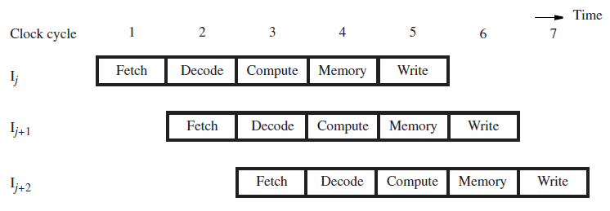
Different parts of different programs are executed at one time instant
Performed using pipelining
Single processor

Slide 6
Multiprocessing
Multiple processors working together
If one processor fails, others can take up the work
Maybe with reduced efficiency
Advantage: improved system performance and reliability
Multiple jobs can operate parallelly
Single job can be partitioned into multiple parallel tasks
Different from multiple computers
Multiple computers with single processor each is connected via a computer network
Each computer is autonomous; may or may not communicate with each other

Slide 7
Two ways of decomposing tasks:
Multiprocessor manufacturers provide an operating system with programming language constructs capable of specifying parallel processing
Provide a compiler with multiprocessor software that can automatically detect parallelism in a user program

Slide 8
Classification of multiprocessors based on how their memory is organized:
Tightly coupled/shared memory:
Common shared memory among the processors
They will have theory own local or shared memory, but primarily they share a common memory accessible to all the processors
Useful when the tasks require high interaction among them

Slide 9
Loosely coupled/distributed memory
Each has its own private local memory
They relay program and data to each other using packets
Consists of a message-passing system
Tied together by a switching scheme designed to route information from one processor to another
Depending on the communication system, the message is accepted
Either by a specified processor
Or the first processor that is available
More efficient when interaction required is low

Slide 10
SISD, MIMD, SIMD, MISD
Computer architecture deals with two things: instruction and data
Conventional uniprocessor:
Single instruction and single data stream
SISD
Ideal multiprocessor:
Multiple instruction and multiple data stream
MIMD

Slide 11
Single instruction multiple data stream (SIMD)
programmers normally write a single program that runs on all processors of an MIMD computer
conditional statements used to determine when different processors should execute different sections of code
Each instruction is divided into multiple processors
Multiple instruction single data stream (MISD)
“stream processor” that would perform a series of computations on a single data stream
Done in a pipelined fashion: parse the input from the network, decrypt the data, decompress it, etc.

Slide 12
Multiprocessors: Shared memory and distributed memory
Multiprocessing: running a program which consists of several cooperating processes
Break down into independent components
Cooperate to solve a single problem
Multiprocessors typically mean MIMD
Have shared or distributed memory

Slide 13
Block diagrams:

Slide 14
Difference is in how computations done in one processor travels to another
Fragmented memory:
When memory is not shared but distributed
Shared memory machines:
Shared memory is joined to processors via interfaces
Interfacing many processors lead to latency
Collisions are possible while memory referencing
In uniprocessors, randomization of requests are done to reduce collisions
Multiprocessors being disconnected, randomization is not effective

Slide 15
Fragmented memory machines:
Requires mapping of data structures across processors
Mapping of communication of intermediate results using send and receive
Messaging overhead encourages storing of intermediate results into a single communication, making messages long
While transmission, the source-destination pair should be disjoint to avoid congestion is the network paths

Slide 16
Parallel processing
Term used to denote a large class of techniques that are used to provide simultaneous data processing tasks
Concurrent data processing
Purpose: increase computational speed
Eg: in the same time-frame
Instruction-1 is being performed in ALU
Instruction-2 is being read from memory
Sometimes there may be two ALUs to perform two computations simultaneously

Slide 17
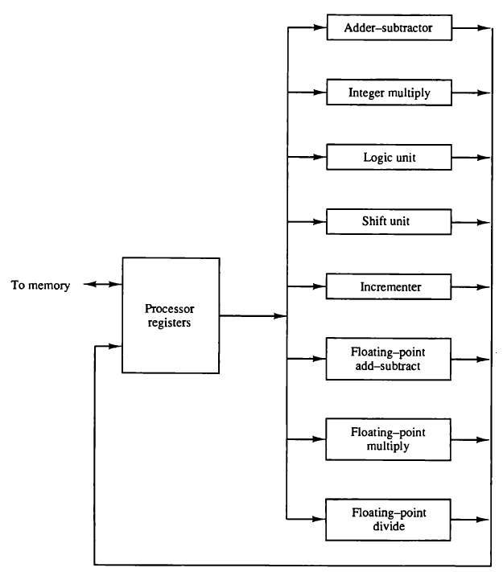
Processor with multiple functional units
Each unit is independent
Eg: one number can be shifted while another number can be incremented

Slide 18
Pipeline
Instruction Ij is fetched in the first cycle and moves through the remaining stages in the following cycles.
In the second cycle, instruction Ij+1 is fetched while instruction Ij is in the Decode stage where its operands are also read from the register file.
In the third cycle, instruction Ij+2 is fetched while instruction Ij+1 is in the Decode stage and instruction Ij is in the Compute stage where an arithmetic or logic operation is performed on its operands.

Slide 19
Pipelining is:
A technique of decomposing a sequential process (task) into sub-operations
Each sub-process being executed in a special, dedicated segment that operates concurrently with other segments
Each segment performs partial processing dictated by the way the task is partitioned
The result from one segment is transferred to the next segment
Final result is obtained after the data have passed through all segments
Each segment usually has registers and a combinatorial circuit

Slide 20
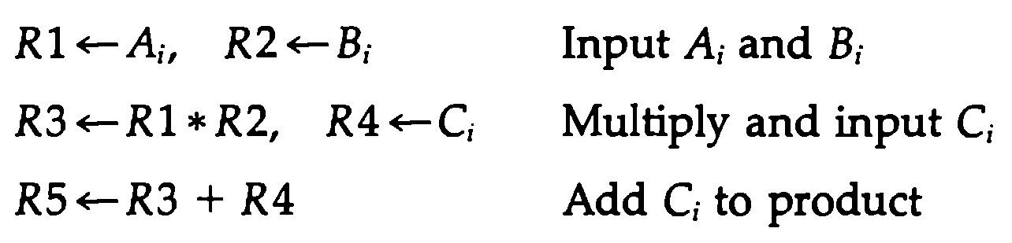
Example
Find the value of he following equation:
The equation consists of addition and multiplication
Consider we have 5 registers R1 to R5
Following are the sub-operations
Morris Mano: Page 311

Slide 21
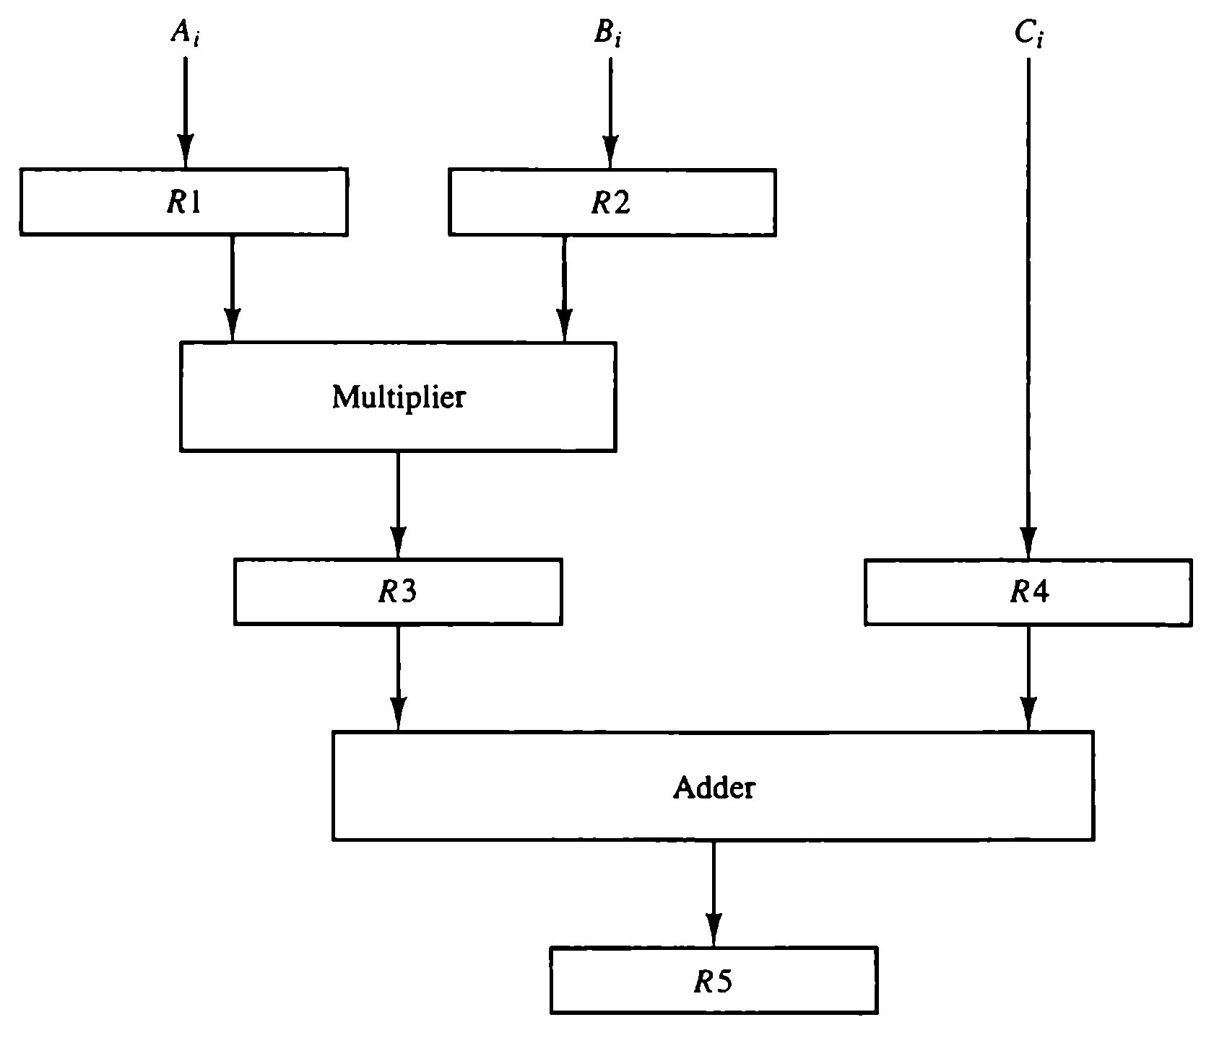

Slide 22
Vector processing
Many applications require large amount of computations
Takes conventional computers days or weeks: not useful
Solution:
Many scientific processors require arithmetic operations on large arrays of numbers
Usually formed as vectors or matrices of floating-point numbers
Can be solved using vector processing
Application areas: long-range weather forecasting, petroleum exploration, artificial intelligence and expert systems etc.

Slide 23
Consider the instruction: A[100]+B[100]
A, B: vectors of length 100
A[i], B[i]: i-th numbers in the vectors A and B respectively
Conventional computers: processes operand one at a time
Vector operations broken down into single computations
Each V[i] refers to a memory location where the number is stored where V is a vector
For addition of the numbers in vectors A and B, 100 steps would be performed to find the result

Slide 24
Vector processing: eliminates the overhead associated with fetching and executing the instructions individually
Single vector instruction: C(1:100)=A(1:100)+B(1:100)
One possible instruction format for a vector operation
3-address instruction:
Base address of the operands (two vectors)
Length of the data items on the vector

Slide 25
Array Processors
Processor that performs computations on large arrays of data
Two types:
Attached array processor: auxiliary processor attached to a general-purpose computer
SIMD array processor: multiple units responding to a common instructions

Slide 26
Attached array processor
Purpose is to enhance the performance of the computer by providing vector processing for complex scientific applications
Achieves high performance by means of parallel processing with multiple functional units

Slide 27
Host computer: general purpose commercial computer
Attached array processor: back-end machine driven by host computer
Connected through I/O controller
Treated as an external interface
Data transfer is done through a high-speed bus from main memory to local memory

Slide 28
SIMD array processor
Computer with multiple processing units operating in parallel
The processing units are synchronised to perform the same operation under the control of a common control unit

Slide 29
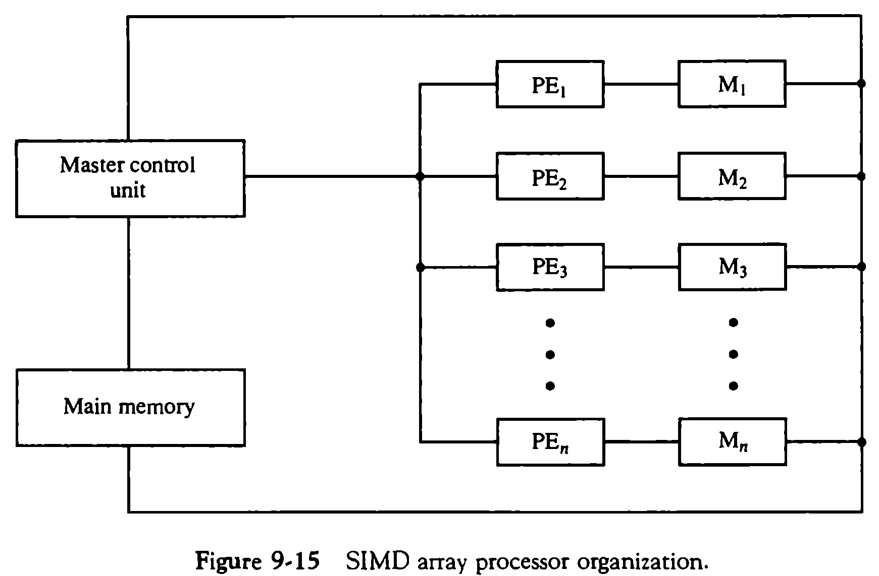
A generic block diagram for SIMD array processor
PE: processing elements
No. of identical PEs
Each have their local memory M
Each PE has
ALU
Floating-point arithmetic unit
Working registers
Master control unit: control operations in the Pes
Main memory: storage of the program
Morris Mano, page 337

Slide 30
Arithmetic Pipeline
Usually found in high-speed computers
Used to implement
Floating-point operations
Multiplication of fixed-point numbers
Similar computations encountered in scientific problems
Example: addition and subtraction pipeline for two normalized floating-point nos.

Slide 31
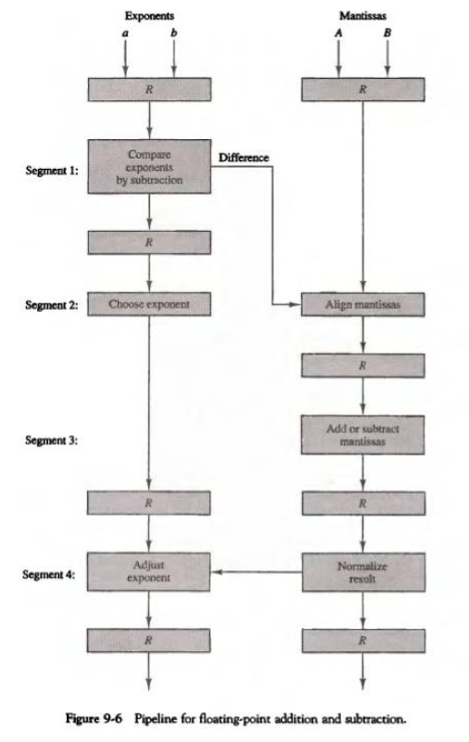
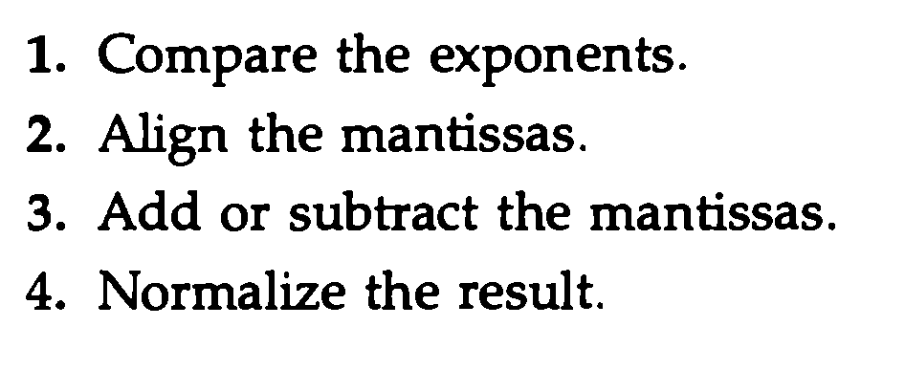
Pipeline for two binary nos.
A, B: mantissas
a, b: exponents
R: register for storing intermediate results
Steps:

Slide 32
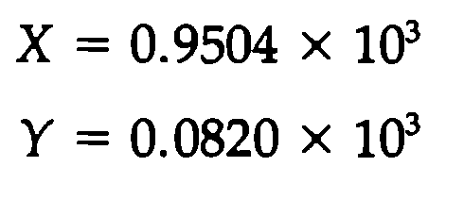
Example:
Consider the two decimal numbers:
Step-1,2:
Exponent 3 is higher, thus chosen as the exponent of the result
3-2=1, shift mantissa of Y by 1
Mantissas are aligned now
Step-3:
Add the mantissas

Slide 33
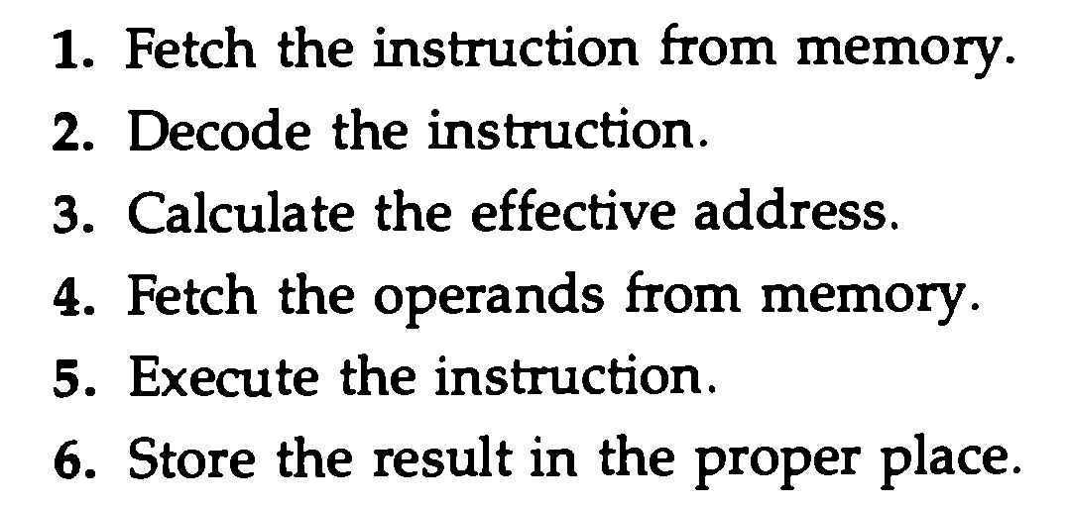
Instruction Pipeline
Pipeline processing in the instruction stream
An instruction stream reads consecutive instructions from the memory while previous instructions are being executed in other segments.
In general case, following are the sequence of steps a computer needs to process each instruction:

Slide 34
Pipeline does not always operate at its maximum rate:
Different segments may take different times to operate o the incoming information
Some segments are skipped for certain operations
Two or more segments might need to access the same memory location, causing one segment to wait until the other finishes

Slide 35
Example: Four-segment Instruction Pipeline
The organization of an instruction pipeline will be more efficient if the instruction cycle is divided into segments of equal duration.
One of the most common examples of this type of organization is a Four-segment instruction pipeline.
combines two or more different segments and makes it as a single one
Eg: instruction execution and storing of results can be combined into a single segment
Morris mano, page 320

Slide 36
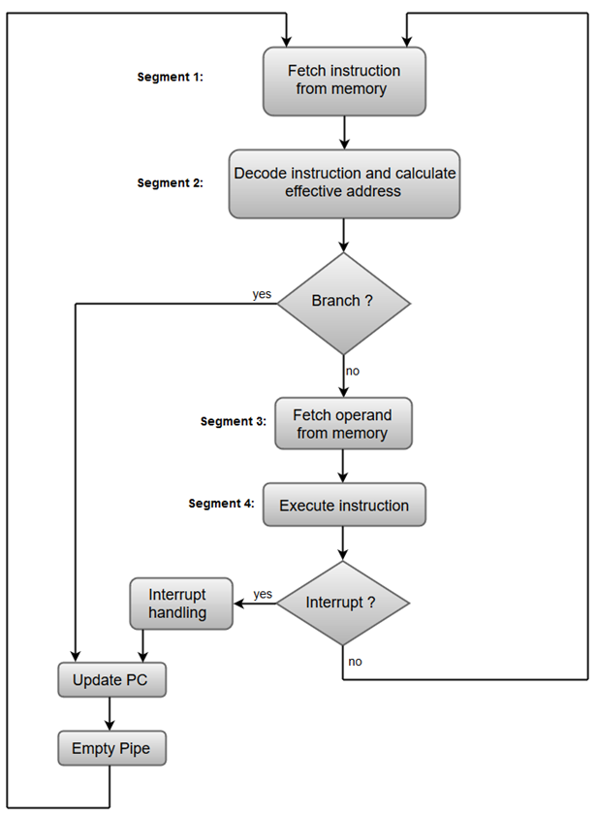
Segment-1 (FI): The instruction fetch segment can be implemented using FIFO buffer.
Segment-2 (DA): The instruction fetched from memory is decoded in the second segment, and eventually, the effective address is calculated in a separate arithmetic circuit.
Segment-3 (FO): An operand from memory is fetched
Segment-4 (EX): The instructions are finally executed in the last segment of the pipeline organization.

Slide 37
In the absence of branch instructions, each segment operates on different instructions
Step-4: four instructions (I1-I4) in four different segments

Slide 38
Assume: instruction-3 is branch instruction
Will branch after DA
Transfer of other instructions from FI to DA is halted until branch instruction I3 is complete
I3 completes at step-6, so I4 resumes at step-7, and rest continues

Slide 39
Pipeline conflicts
Resource Conflicts
Access to memory by two segments at the same time
Most can be resolved by using separate instruction and data memories
Data Dependency Conflicts
Instruction depends on the result of some previous instruction
Result is not available yet
Branch Difficulties
Branching and other instructions that change the value of the PC

Slide 40
Data Dependency
Collision occurs when an instruction cannot proceed because previous instructions did not complete certain operations
Eg:
instruction in the FO segment needs to fetch an operand that is being generated by a previous instruction is segment EX
Second instruction must wait for the data from the first instruction
Address dependency: operand inaccessible because data required by the addressing mode is not available

Slide 41
Solutions
Hardware interlocks:
Circuit that detects instructions whose source operands are destinations of instruction farther up in the pipeline
Detection of this situation causes the instruction whose source is not available to be delayed by enough clock cycles to resolve the conflict
Operand forwarding:
Uses special hardware to detect a conflict
Avoids it by routing the data through special paths between pipeline segments

Slide 42
Eg of operand forwarding:
ALU result to transfer to destination register
Hardware checks if it is needed as a source in the next instruction
If yes, result is passed directly as an ALU input for the next instruction bypassing the register file
Delayed loading:
Compiler does data conflict resolution while translating the high-level programming language into machine language problem
Compier for such computers is designed to detect a data conflict and resorder instructions as necessary
Delay the loading of the conflicting data by inserting no-operation instructions, thus delayed loading

Slide 43
Handling of Branch instructions
Branch instructions can be conditional or unconditional
Unconditional: always alters the sequential program flow by loading the PC (program counter) with the target address
Conditional: control selects target instruction if condition is satisfied or next sequential instruction if target is not satisfied
Pipeline computers employ various hardware techniques to minimize the performance degradation caused by instruction branching

Slide 44
Prefetch target instruction:
Prefetch both target instruction and the instruction following the branch
Both are saved until the branch is executed
If condition is satisfied, the pipeline continues from branch target instruction
Extension: continue fetching instructions from both places till branch decision is made
Control chooses the instruction stream of the correct program flow

Slide 45
Branch target buffer
Branch target buffer or BTB: an associative memory included in the fetch segment of the pipeline
Each entry in BTB consists of address of previously executed branch instruction, target instruction of the branch, next few instructions after the branch target instruction
When pipeline decodes a ranch instruction, it searches the BTB for the instruction address
If present, instruction is available directly and prefetch continues from new path
If not, pipeline shifts to new instruction stream and stores target instruction in BTB
Advantage: branch instructions that have occurred previously are readily available

Slide 46
Loop buffer:
Variation of BTB
Small, very high-speed register file maintained by instruction fetch segment of the pipeline
When a program loop is detected, all of it instructions are stored in the loop buffer
Later, loop can be accessed directly without having to access memory until loop mode is removed by final branching out
Branch prediction:
Pipeline with branch prediction uses some additional logic to guess the outcome of a conditional branch instruction before it is executed
Pipeline then begins prefetching instructions from the predicted path
Correct prediction reduces time wastage due to branch penalties

Slide 47
Delayed branch:
Compiler detects branch instructions
Rearranges the machine language code sequence by inserting useful instructions that keep the pipeline operating without interruptions
Eg: insertion of a no-operation instruction after a branch instruction

Slide 48
RISC
RISC: Machine with a very fast clock cycle that executes at the rate of one instruction per cycle
ability to use an efficient instruction pipeline
fixed-length instruction format
decoding of the operation can occur at the same time as the register selection
All data manipulation instructions have register-toregister operations
no need for calculating an effective address or fetching of operands from memory

Slide 49
Single-cycle instruction execution
start each instruction with each clock cycle
pipeline the processor to achieve the goal of single-cycle instruction execution
RISC can achieve pipeline segments requiring just one clock cycle
Compiler support
RISC processors rely on the efficiency of the compiler to detect and minimize the delays: data conflicts and branch penalties

Slide 50
Example: Three-Segment Instruction Pipeline
The instruction cycle can be divided into three suboperations and implemented in three segments
I: Instruction fetch
fetches the instruction from program memory
A: ALU operation
the instruction is decoded and an ALU operation is performed
E: Execute instruction
directs the output of the ALU to destination register, data memory, or PC
Morris Mano, page 325

Slide 51
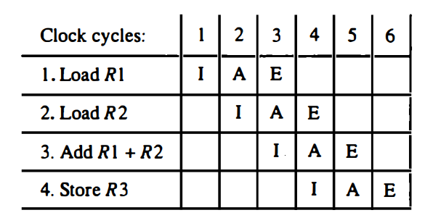
Delayed Load
Consider the following:
LOAD: R1 ← M[address 1]
LOAD: R2 ← M[address 2]
ADD: R3 ← R1 + R2
STORE: M[address 3] ← R3
Pipeline timing with data conflict
there will be a data conflict in instruction 3 because the operand in R2 is not yet available in the A segment

Slide 52
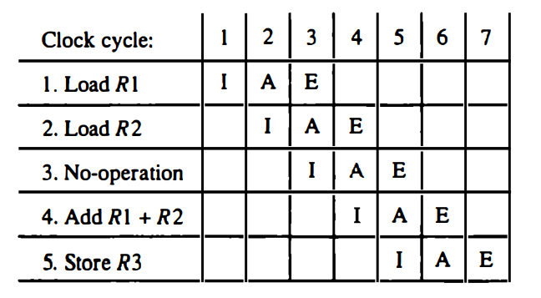
Pipeline timing with delayed load
no-op instruction inserted after the load to R2 instruction
used to advance one clock cycle in order to compensate for the data conflict in the pipeline

Slide 53
Delayed Branch
Compiler analyze the instructions before and after the branch
rearrange the program sequence by inserting useful instructions in the delay steps
Example: program consists of five instructions
Load from memory to R1
Increment R2
Add R3 to R4
Subtract R5 from R6
Branch to address X

Slide 54
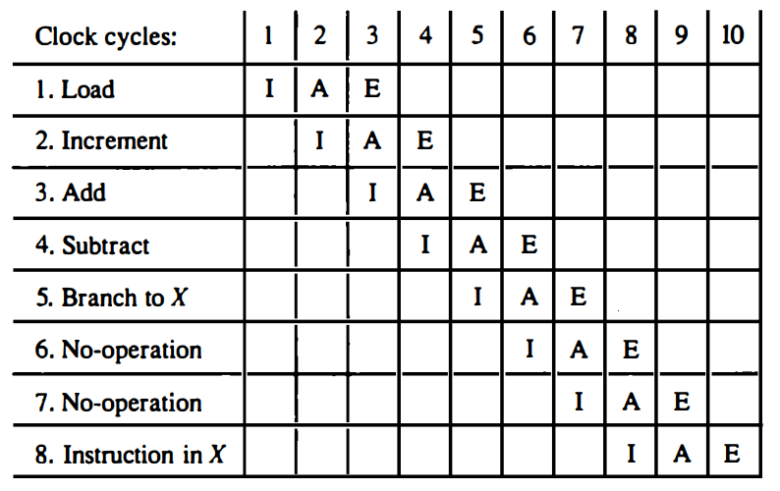
Using no-operation instructions
compiler inserts two no-op instructions after the branch

Slide 55
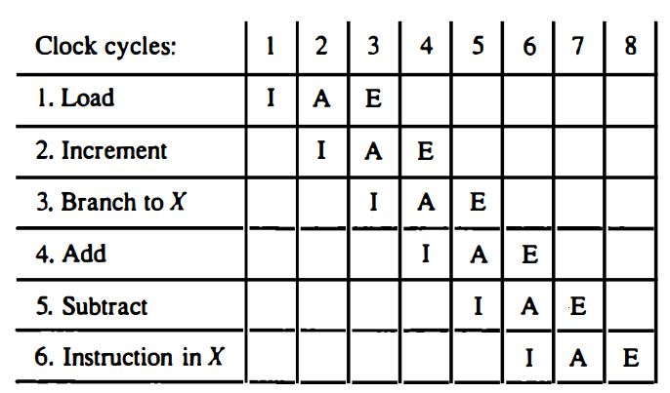
Rearranging the instructions
rearranged by placing the add and subtract instructions after the branch instruction instead of before as in the original program

Slide 56
Thank you!

